Slide 1

Module 13: Identifying Transactional and SRMW Data for Analysis
0/5
Analytics: Data Warehouse Developer (Siebel 7.7)
Notes:
Time: Lecture: 20 minutes; labs: 10 – 20 minutes
Intent: To use Siebel Call Center, Siebel Tools, and Data Model Reference (DMR) for Data Warehouse guide to identify tables and columns used to extract data from the Siebel transactional database for analysis in the Siebel Relationship Management Warehouse.
Flow: Use Siebel Call Center to identify business component definition; use Siebel Tools to identify correct source table and column that store data in Siebel transactional database; use SRMW data model reference to identify a dimension and its corresponding extension and staging extension tables and columns.
Key Terms:
Siebel Call Center
Siebel Tools
Business component definition
Dimension table
Extension table
Staging extension table
Mapping
13

Slide 2
Module Objectives
After completing this module you will be able to:
  Use Siebel eBusiness applications to identify tables and columns you will use to extract data from the Siebel transactional database for analysis
  Identify a suitable extension table and column in the SRMW to store data from the Siebel transactional database
Why you need to know:
  Before extending the SRMW to accommodate new data, it is necessary to identify the correct tables and columns in the Siebel transactional database and SRMW
Notes:
Each objective and “why you need to know” should be stated aloud.

Slide 3
Identify Data for Analysis
Extending the SRMW involves performing data analysis in both Siebel transactional database and SRMW
  Siebel Transactional Database
    Use Siebel Business applications to identify the business component definition
    Use Siebel Tools to identify the table and column that store the data in the Siebel transactional database
  SRMW
    Use SRMW Data Model Reference (DMR) guide to identify the desired star schema, fact, and dimension table
Notes:
This is a structuring slide for the remainder of the module. Each step is presented in detail in a subsequent slide.
For the slides that follow, keep students focused on the main objective: to identify tables and columns in the Siebel transactional database used to extract data for analysis in the Siebel Relationship Management Warehouse. Each step in the slides that follow should be presented in this context. Students should not get sidetracked trying to understand Siebel technology or navigation in Siebel applications.
The first three steps identify how to locate the business component definition in a Siebel eBusiness application.
The next five steps identify how this business component definition is then used in Siebel Tools to identify the correct Siebel transactional database table and column from which data will be extracted and loaded into the Siebel Relationship Management Warehouse.
The last four steps identify how to identify the extension tables and columns in SRMW.
13

Slide 4
Identify the Business Component Definition
0/3
Connect to the Siebel Business application
Navigate to the view with the desired data
Identify the business component definition
Notes:
This is a structuring slide. Do not teach the steps or concepts here because the following slides cover them in detail.

Slide 5
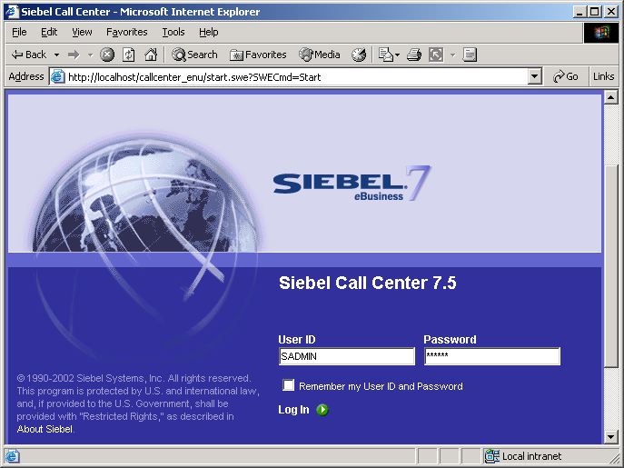
1. Connect to Siebel Business Application
1/3
Open the browser to connect to the desired Siebel eBusiness application
Type URL
Enter User ID and Password
Log in
Notes:
This slide identifies steps for connecting to a Siebel CRM application through a browser. Call Center is used as an example. Callouts provide details.
13

Slide 6
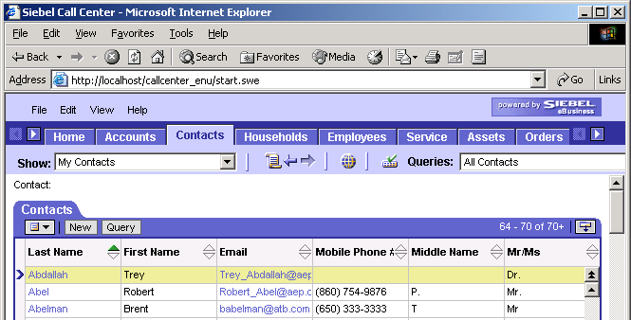
2. Navigate to View with Desired Data
2/3
For example, if you are looking for email, navigate to the My Contacts view
Click View tab
Desired data
Notes:
This slide identifies the steps for navigating to a view in a Siebel CRM application that contains the desired data to be extracted from the Siebel transactional database and loaded into the Siebel Relationship Management Warehouse for analysis. The example is Email in the My Contacts view. Callouts provide details.

Slide 7
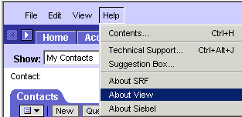
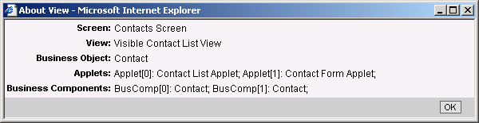
3. Identify Business Component Definition
3/3
Use About View in the desired view to identify the business component definition
Select Help > About View
Identify business component definition
Notes:
This slide illustrates the steps for identifying the business component definition in the view. In Siebel Tools, this business component definition is used to identify the table and column that holds the data in the Siebel transactional database. Steps for using the business component definition to identify the table and column in Siebel Tools are presented in the slides that follow.
If students ask: A business component represents one fundamental business entity in the Siebel enterprise. Examples include Service Request, Contact, Activity. A business component references a base table and consists of multiple fields that characterize the business component.
13

Slide 8
Identify the Transactional Database Table and Column
0/6
Start Siebel Tools
Navigate to the business component
Open the View Details Window
Identify the table and column
Identify the column properties
Notes:
This is a structuring slide. Do not teach the steps or concepts here because the following slides cover them in detail.

Slide 9
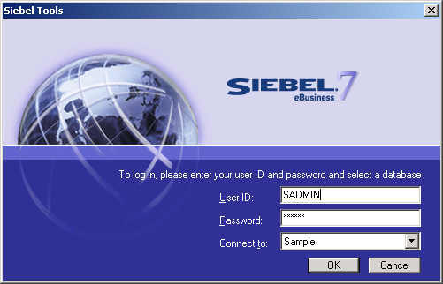
1. Start Siebel Tools
1/6
Select Start > Programs > Siebel Tools 7.7 > Siebel Tools
Notes:
Identifies navigation steps to open Siebel Tools.
13

Slide 10
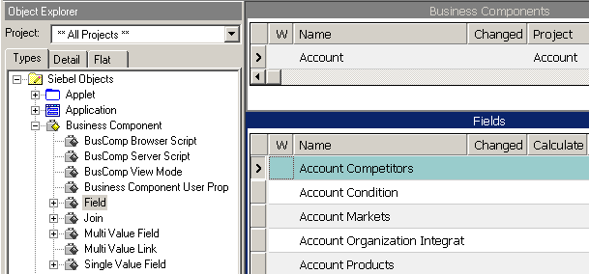
1. Navigate to Business Component
2/6
Select object types and definitions alternately to examine child object definitions
1. Expand parent object type (Business Component) in Object Editor (OE)
2. Select parent object definition in Object List Editor (OBLE)
Use Types tab
3. Select desired child object type (Field) in Object Editor (OE)
4. View child object definitions for selected parent definition in lower pane of Object List Editor (OBLE)
Notes:
This slide identifies the steps for navigating to Siebel repository objects using Siebel Tools. Keep the focus on the business component and fields under it. Callouts provide details.

Slide 11
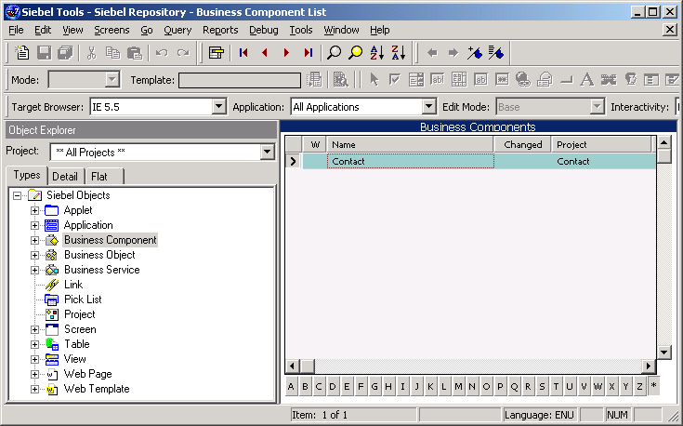
1. Navigate to Business Component Continued
3/6
Select the business component that contains the data
Query for business component definition in OBLE
Click Business Component in OE
Notes:
Identifies how to locate the desired business component definition in Siebel Tools. Callouts provide details. Continues with the Contact example used in earlier slides.
13

Slide 12
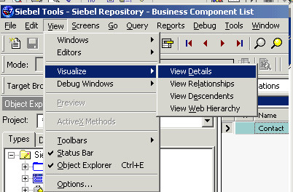
3. Open View Details Window
4/6
Select View > Visualize > View Details
Notes:
Identifies navigation to open the View Details window. Explanation of View Details window is provided on the slide that follows.

Slide 13
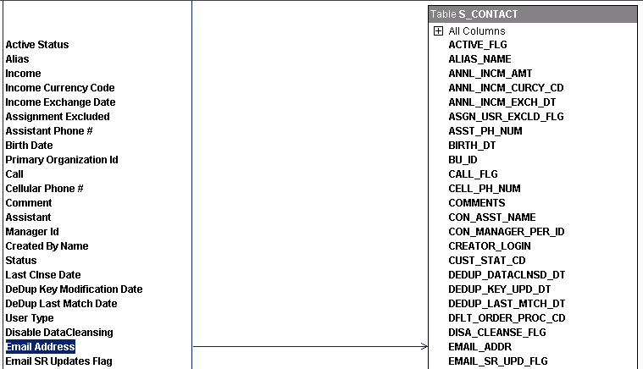
4. Identify Table and Column
5/6
Typical business component details view
View Details window
Left-most column lists all fields for business component
Click desired field
Arrow identifies OLTP table and column
Arrow identifies OLTP table and column
Notes:
View Details window is one method in Siebel Tools used to identify mappings between business component definitions and their corresponding transactional database tables and columns. Students may ask about other methods. Tell them if you know, but do not spend a lot of time discussing Siebel Tools. It is not the focus of this module.
13

Slide 14
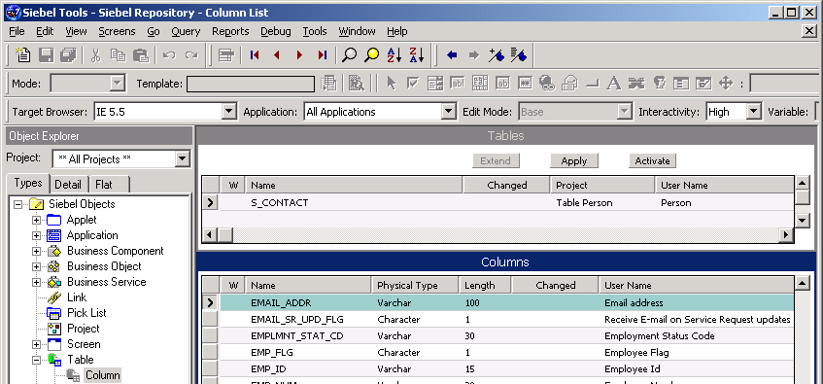
5. Identify Column Properties
6/6
Select Object Type in OE :: Object Definition in OBLE | Child Object Type in OE :: Child Object Definition in OBLE
Object definition
Object type
Child object definition
Column properties
Child object type
Notes:
The bullet on this slide uses the standard Tools navigation to identify the child object definition and the corresponding column and column properties. For the purposes of this module, it is not important for students to fully understand navigation in Tools. It is important that they understand how Tools is used to identify the appropriate table, column and column properties in the Siebel transactional database.

Slide 15
Identify the SRMW Table and Column
0/4
Identify the base dimension table
Identify the corresponding extension table
Identify a suitable column in the target table
Identify the corresponding extension staging table
Notes:
This is a structuring slide. Do not teach the steps or concepts here because the following slides cover them in detail.
13

Slide 16
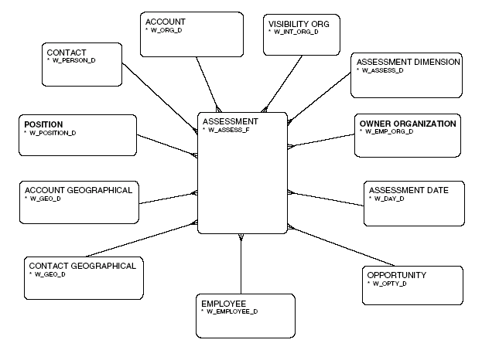
Identifying a Dimension Table
1/4
Use SRMW data model reference to identify the desired star schema, fact, and dimension table
Example:
  Assessment Dimensional Schema
Notes:
The SRMW data model reference contains diagrams of each of the star schemas used in Siebel Analytics.
This slide provides a sample star schema diagram from the SRMW data model reference. It identifies the SRMW table names for the Assessment fact and related dimension tables. The next step is to identify the correct extension tables.
Please note: The SRMW data model reference guide is not provided as part of the materials for this course. However, customers do receive a copy of the SRMW data model reference when they purchase the product. As such, students do not use the SRMW data model reference in the labs, but they need to know how to use the DMR to understand what is preconfigured and gather the information needed to customize the SRMW.
The CONTACT/W_PERSON_D example is used throughout the module. The scenario is: Identify the correct extension table and column to use for the CONTACT/W_PERSON_D dimension table to store data from the Siebel transactional database.

Slide 17
Identifying the Corresponding Extension Table
2/4
The extension table is the target table where the new data is ultimately stored
  Extension table has naming convention W_*_DX
  Example: W_PERSON_DX
Notes:
Extension tables are identified based on the naming convention provided in this slide. Extension tables are designed so that there is a 1:1 mapping between dimension and fact records to the extension records.
Continuing with the example in this module, W_PERSON_DX is the corresponding extension table for W_PERSON_D.
13

Slide 18
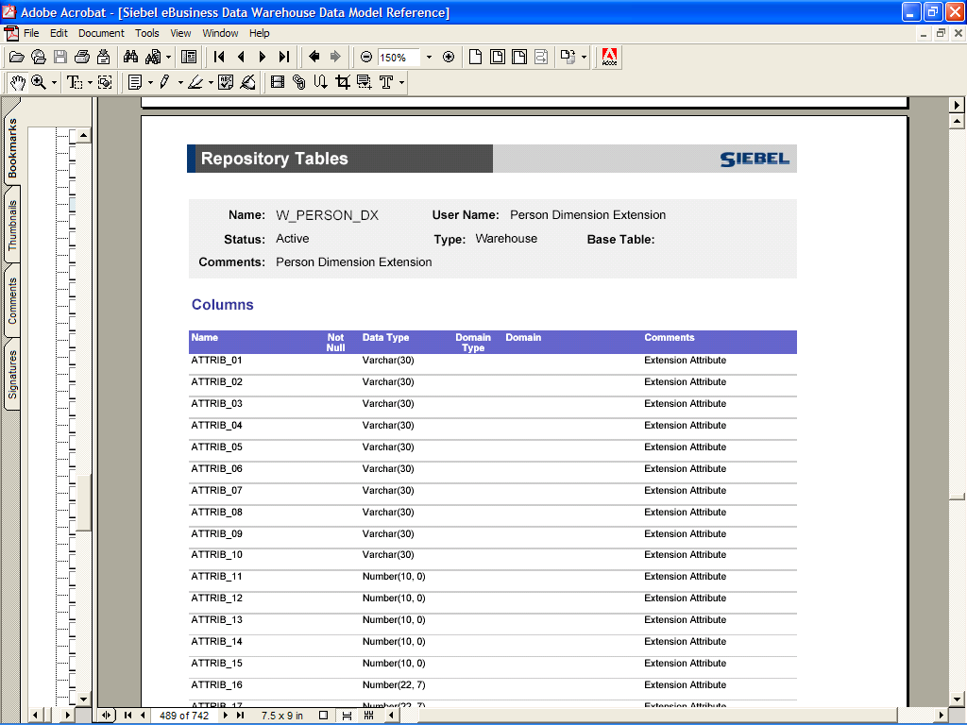
Identifying Column in Target Table
3/4
Use DMR mapping tables to identify column in target extension table where data is stored
Dimension extension table
Dimension extension table columns
Notes:
The SRMW data model reference provides a list of all SRMW tables with information about columns, column properties, indexes, and so forth. Use these table lists in the DMR to identify the column in a target extension table where data will be stored.
Continuing with the example in this module, identify an appropriate column in W_PERSON_DX to store the data from the Siebel transactional database.

Slide 19
Identifying the Corresponding Staging Extension Table
4/4
The staging extension table is where data is initially loaded in SRMW after running source-dependent extract session
  Staging extension table has naming convention W_*_DSX
  Example: W_PERSON_DSX
Notes:
Staging tables are used primarily to stage incremental data from the Siebel transactional database. When the ETL process is run, staging tables are truncated before they are populated with incremental data.
During the initial full ETL load, these staging tables hold the entire data set, but they only hold a small volume of data during subsequent refresh ETL runs.
Stage data is transformed in SDE sessions and loaded into dimension or fact staging tables. From the staging tables, data is loaded via SIL sessions into SRMW target tables, including extension tables.
Extension tables have a corresponding staging extension table. Staging extension tables are identified based on the naming convention provided in this slide.
Continuing with the example in this module, W_PERSON_DSX is the corresponding staging extension table for the W_PERSON_DX extension table.
13

Slide 20
Summary
This module showed you how to:
  Use Siebel eBusiness applications to identify tables and columns you will use to extract data from the Siebel transactional database for analysis
  Identify a suitable extension table and column in the SRMW to store data from the Siebel transactional database
Notes:
This slide presents a summary of the topics covered in the module.
Review Questions:
Question: True or False. A business component definition is used to identify the table and column that holds the data in the Siebel Relationship Management Warehouse.
Answer: False. A business component definition is used to identify the table and column that holds the data in the Siebel transactional database
Question: True or False. Data is loaded via an SDE mapping directly from a Siebel transactional database table into a SRMW extension table.
Answer: False. The SDE mapping loads data initially into a staging extension table. An SIL mapping loads data from the staging extension table into the extension table.

Slide 21
Lab
In the lab you will:
  Use the Siebel Call Center and Siebel Tools applications to identify the table and column you will use to extract data from the Siebel transactional database
  Identify a suitable extension table and column in the SRMW to store new data
Notes:
Labs and Troubleshooting:
Students attending this course may be completely unfamiliar with the Siebel applications presented in this module. Be prepared to assist students with navigation.
This module presented the SRMW data model reference as a method for identifying customization information. However, students do not use the DMR in the labs. Rather, they use MS SQL Server Enterprise Manager as an alternative method for identifying SRMW extension tables and columns.
If students question this, remind students that the SRMW data model reference is not provided as part of the materials for this course, but they do receive a copy of the SRMW data model reference when they purchase the product. As such, even though students do not use the SRMW data model reference in the labs, they need to understand how to use the DMR to gather the information needed to customize the SRMW.
This lab is connected to the customization labs that follow this module to the extent that identifying transactional data for analysis is one of the steps in the customization process. However, labs that follow in subsequent modules are not dependent on the outcome of this lab.
13

